Slide 1

Visualization Analysis & Design
Data Abstraction (Ch 2)
Tamara Munzner

Slide 2
What does data mean?

Slide 3
What does data mean?
14, 2.6, 30, 30, 15, 100001
What does this sequence of six numbers mean?

Slide 4
What does data mean?
14, 2.6, 30, 30, 15, 100001
What does this sequence of six numbers mean?
two points far from each other in 3D space?

Slide 5
What does data mean?
14, 2.6, 30, 30, 15, 100001
What does this sequence of six numbers mean?
two points far from each other in 3D space?
two points close to each other in 2D space, with 15 links between them, and a weight of 100001 for the link?

Slide 6
What does data mean?
14, 2.6, 30, 30, 15, 100001
What does this sequence of six numbers mean?
two points far from each other in 3D space?
two points close to each other in 2D space, with 15 links between them, and a weight of 100001 for the link?
something else??

Slide 7
What does data mean?
14, 2.6, 30, 30, 15, 100001
What does this sequence of six numbers mean?
two points far from each other in 3D space?
two points close to each other in 2D space, with 15 links between them, and a weight of 100001 for the link?
something else??
Basil, 7, S, Pear

Slide 8
What does data mean?
14, 2.6, 30, 30, 15, 100001
What does this sequence of six numbers mean?
two points far from each other in 3D space?
two points close to each other in 2D space, with 15 links between them, and a weight of 100001 for the link?
something else??
Basil, 7, S, Pear
What about this data?

Slide 9
What does data mean?
14, 2.6, 30, 30, 15, 100001
What does this sequence of six numbers mean?
two points far from each other in 3D space?
two points close to each other in 2D space, with 15 links between them, and a weight of 100001 for the link?
something else??
Basil, 7, S, Pear
What about this data?
food shipment of produce (basil & pear) arrived in satisfactory condition on 7th day of month

Slide 10
What does data mean?
14, 2.6, 30, 30, 15, 100001
What does this sequence of six numbers mean?
two points far from each other in 3D space?
two points close to each other in 2D space, with 15 links between them, and a weight of 100001 for the link?
something else??
Basil, 7, S, Pear
What about this data?
food shipment of produce (basil & pear) arrived in satisfactory condition on 7th day of month
Basil Point neighborhood of city had 7 inches of snow cleared by the Pear Creek Limited snow removal service

Slide 11
What does data mean?
14, 2.6, 30, 30, 15, 100001
What does this sequence of six numbers mean?
two points far from each other in 3D space?
two points close to each other in 2D space, with 15 links between them, and a weight of 100001 for the link?
something else??
Basil, 7, S, Pear
What about this data?
food shipment of produce (basil & pear) arrived in satisfactory condition on 7th day of month
Basil Point neighborhood of city had 7 inches of snow cleared by the Pear Creek Limited snow removal service
lab rat Basil made 7 attempts to find way through south section of maze, these trials used pear as reward food

Slide 12
Now what?
semantics: real-world meaning

Slide 13
Now what?
semantics: real-world meaning

Slide 14
Now what?
semantics: real-world meaning
data types: structural or mathematical interpretation of data
item, link, attribute, position, (grid)
different from data types in programming!

Slide 15
Items & Attributes
item: individual entity, discrete
eg patient, car, stock, city
"independent variable"

Slide 16

Items & Attributes
item: individual entity, discrete
eg patient, car, stock, city
"independent variable"
item: person

Slide 17
Items & Attributes
item: individual entity, discrete
eg patient, car, stock, city
"independent variable"
attribute: property that is measured, observed, logged...
eg height, blood pressure for patient
eg horsepower, make for car
"dependent variable"
item: person

Slide 18




Items & Attributes
attributes: name, age, shirt size, fave fruit
item: individual entity, discrete
eg patient, car, stock, city
"independent variable"
attribute: property that is measured, observed, logged...
eg height, blood pressure for patient
eg horsepower, make for car
"dependent variable"
item: person

Slide 19
Other data types
links
express relationship between two items
eg friendship on facebook, interaction between proteins
positions
spatial data: location in 2D or 3D
pixels in photo, voxels in MRI scan, latitude/longitude
grids
sampling strategy for continuous data

Slide 20
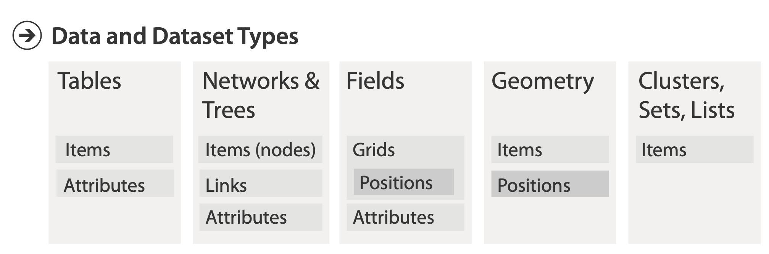
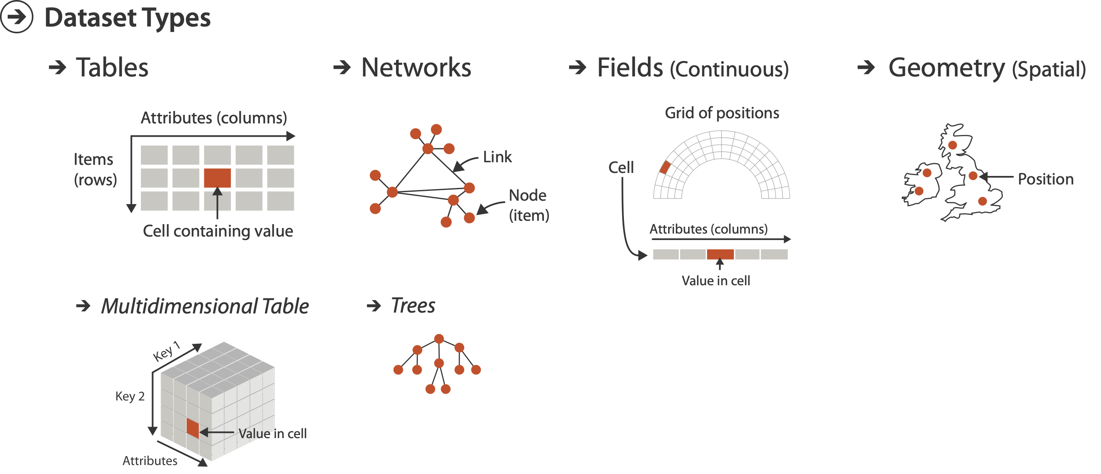
Dataset types
attributes: name, age, shirt size, fave fruit
flat table
one item per row
each column is attribute
cell holds value for item-attribute pair
item: person

Slide 21

Dataset types
attributes: name, age, shirt size, fave fruit
flat table
one item per row
each column is attribute
cell holds value for item-attribute pair
unique key (could be implicit)
item: person

Slide 22
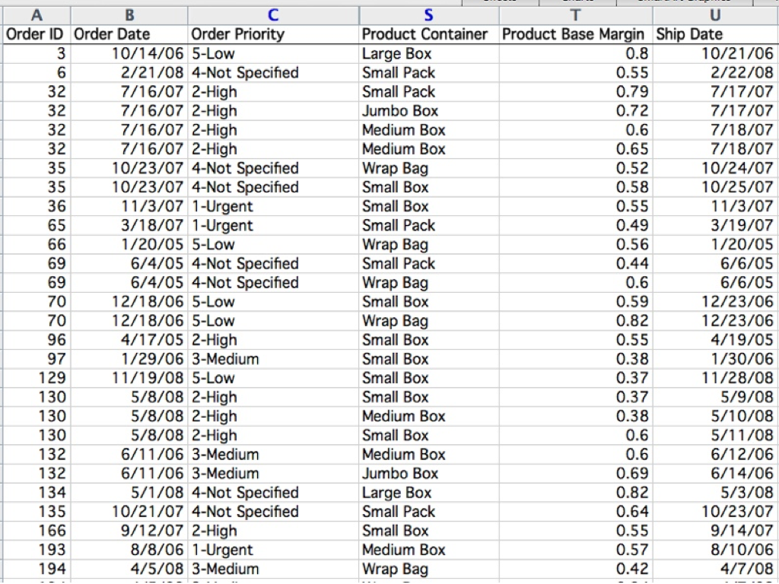
Table

Slide 23


Table
item

Slide 24


Table
item
attribute

Slide 25

Table
item
cell
attribute

Slide 26
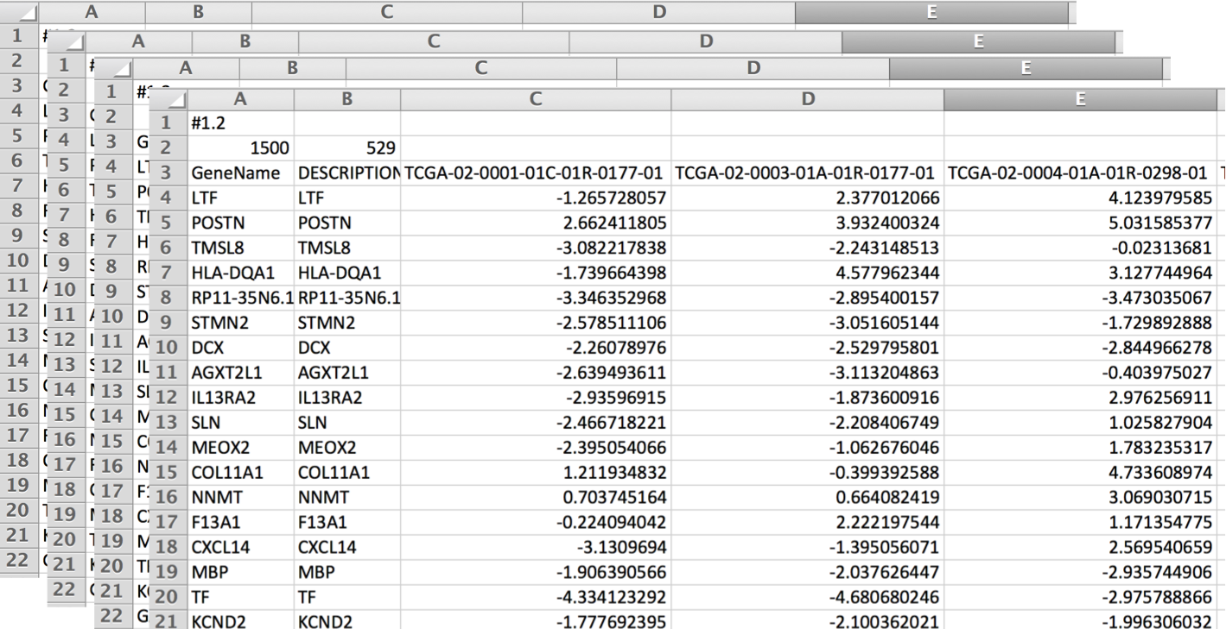
Dataset types
multidimensional tables
indexing based on multiple keys
eg genes, patients

Slide 27
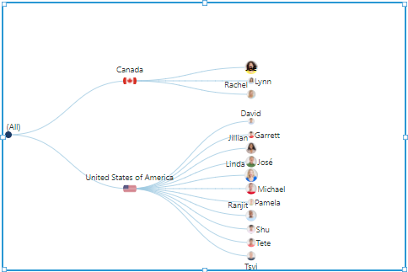
Dataset types
network/graph
nodes (vertices) connected by links (edges)
tree is special case: no cycles
often have roots and are directed

Slide 28
Dataset types
Spatial

Slide 29
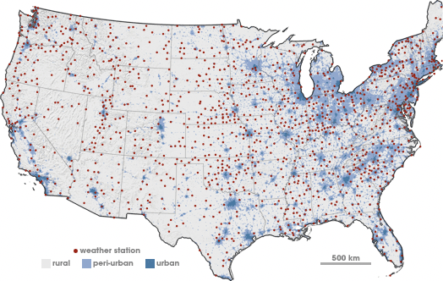
Spatial fields
attribute values associated w/ cells
cell contains value from continuous domain
E.g., temperature, pressure, wind velocity
measured or simulated
Spatial

Slide 30
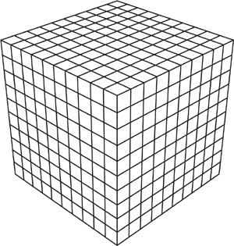

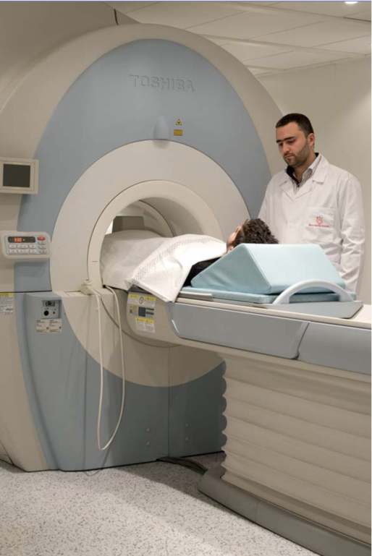
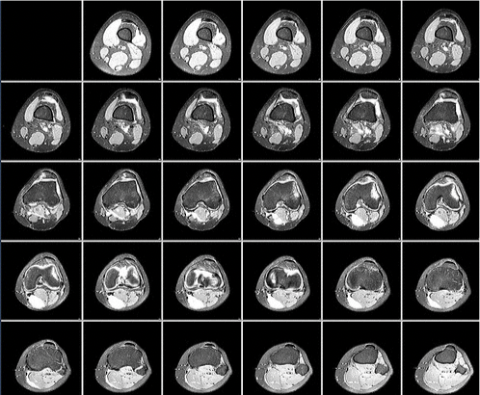
Spatial fields
attribute values associated w/ cells
cell contains value from continuous domain
eg temperature, pressure, wind velocity
measured or simulated
major concerns
sampling: where attributes are measured
interpolation: how to model attributes elsewhere
grid types

Slide 31
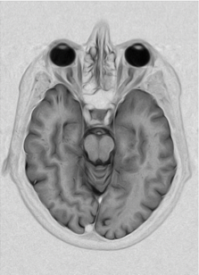

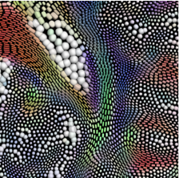
Spatial fields
attribute values associated w/ cells
cell contains value from continuous domain
eg temperature, pressure, wind velocity
measured or simulated
major concerns
sampling: where attributes are measured
interpolation: how to model attributes elsewhere
grid types
major divisions
attributes per cell: scalar (1), vector (2), tensor (many)
scalar
vector
tensor

Slide 32
Dataset types
Spatial

Slide 33
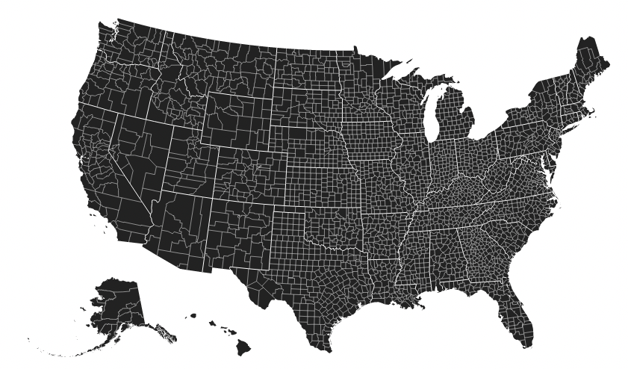
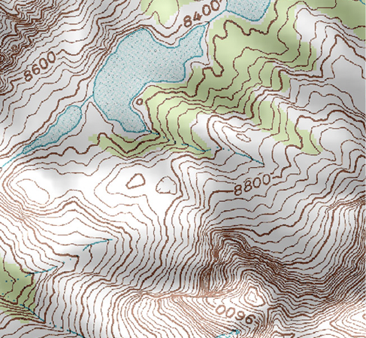
Geometry
shape of items
explicit spatial positions / regions
points, lines, curves, surfaces, volumes
boundary between computer graphics and visualization
graphics: geometry taken as given
vis: geometry is result of a design decision

Slide 34
Dataset types
Spatial

Slide 35
Collections
how we group items

Slide 36
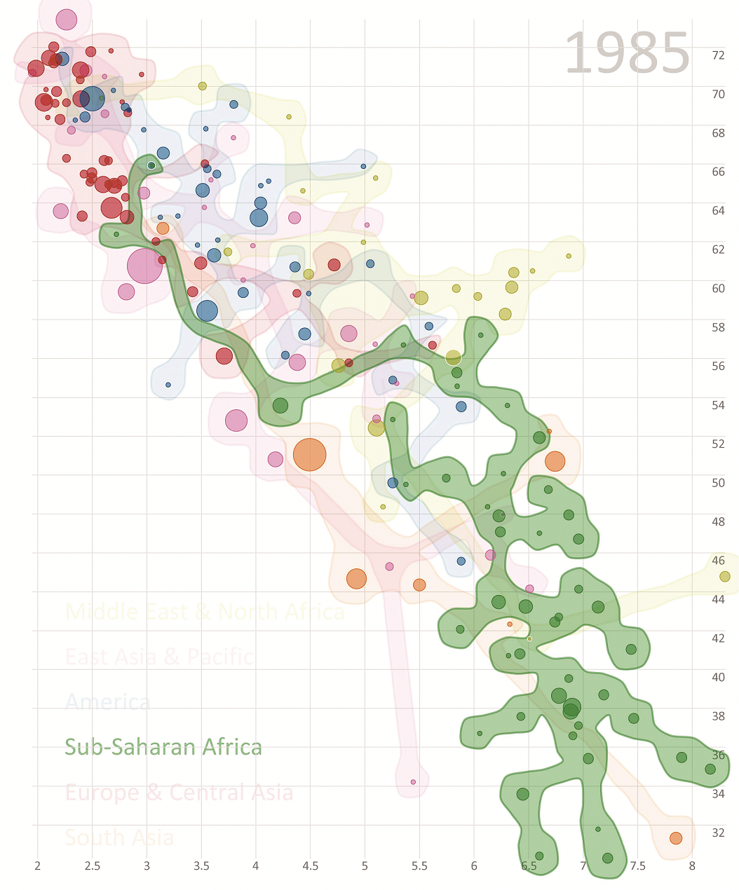
Collections
how we group items
sets
unique items, unordered

Slide 37
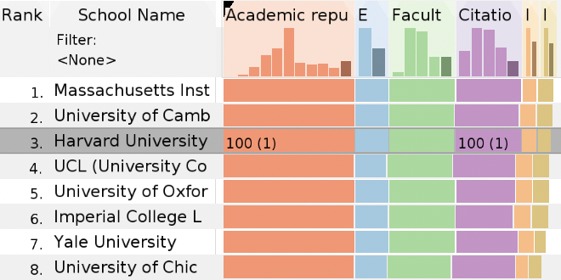
Collections
how we group items
sets
unique items, unordered
lists
ordered, duplicates possible

Slide 38
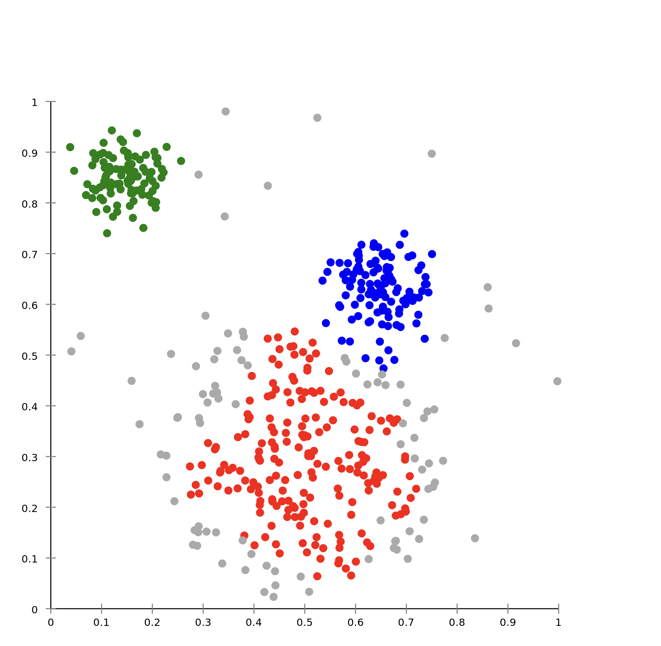
Collections
how we group items
sets
unique items, unordered
lists
ordered, duplicates possible
clusters
groups of similar items

Slide 39

Dataset and data types

Slide 40
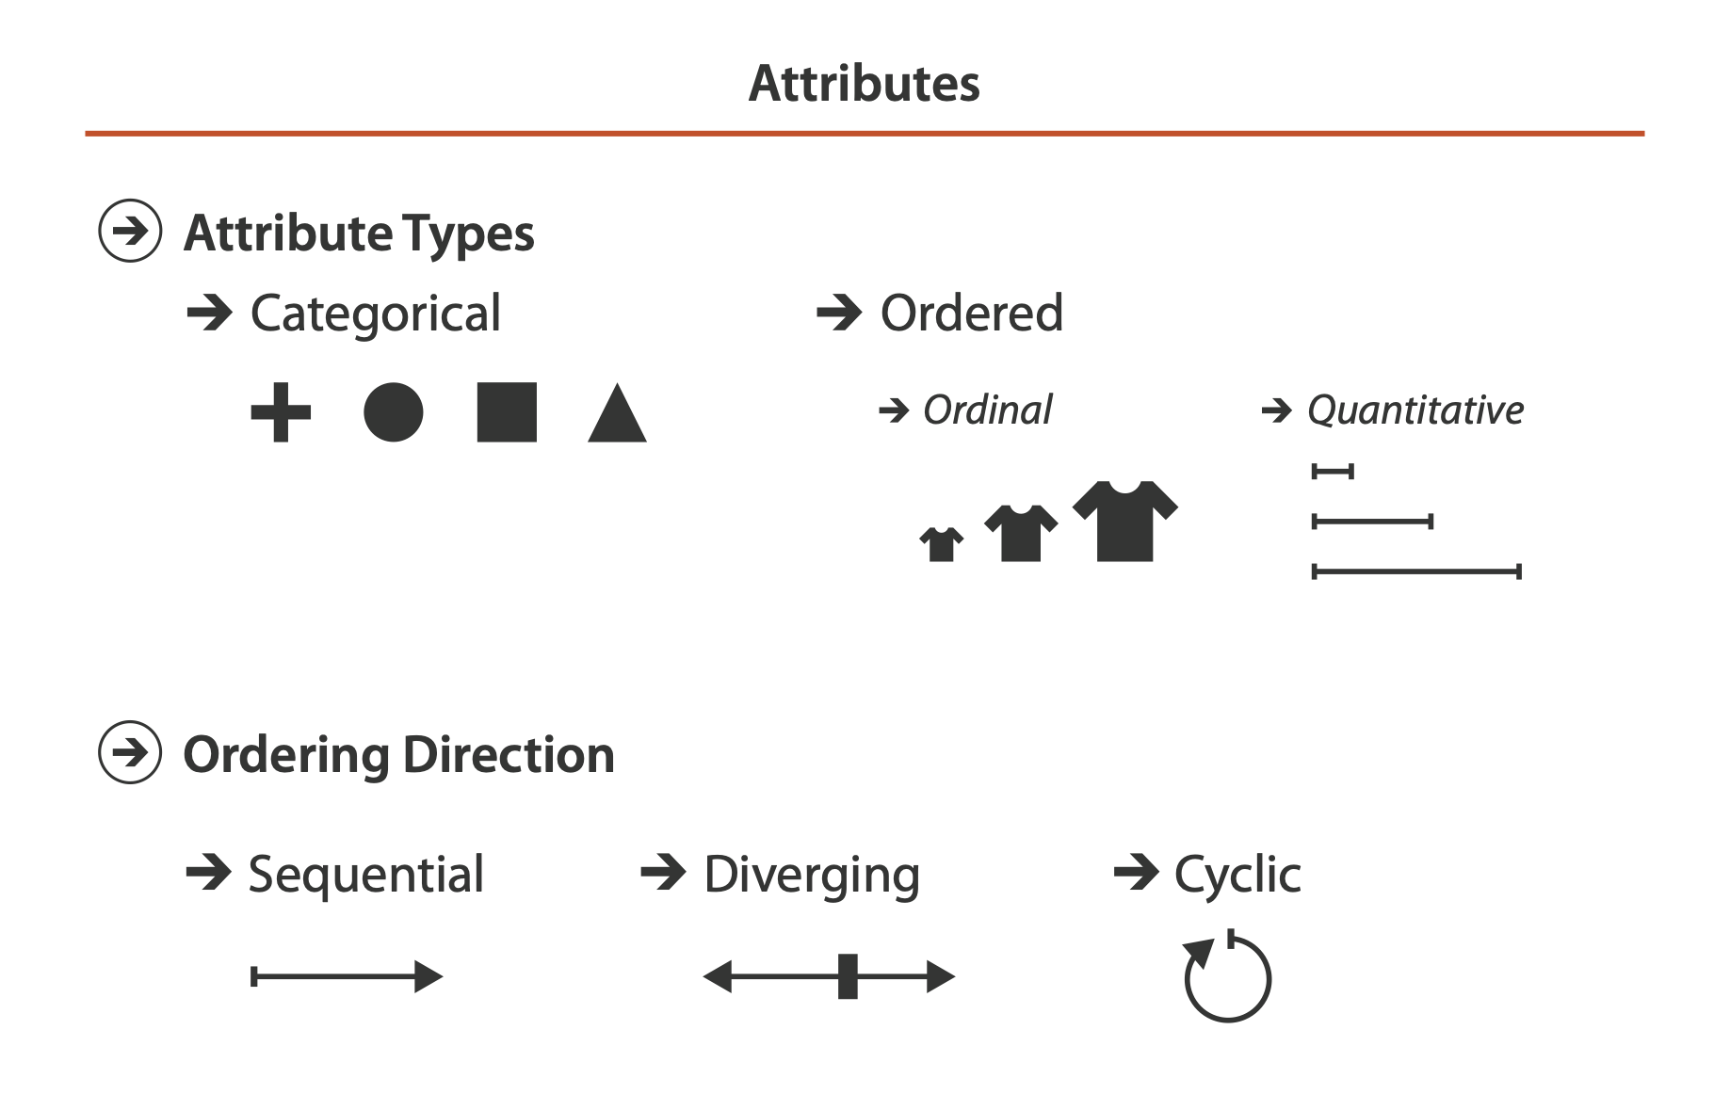
Attribute types
which classes of values & measurements?
categorical (nominal)
compare equality
no implicit ordering
ordered
ordinal
less/greater than defined
quantitative
meaningful magnitude
arithmetic possible

Slide 41
Table

Slide 42
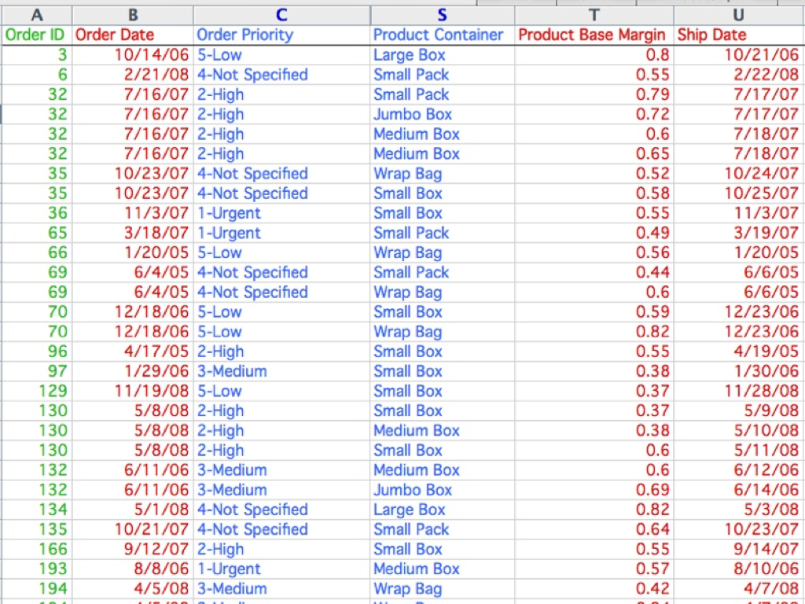
categorical
ordinal
quantitative

Slide 43
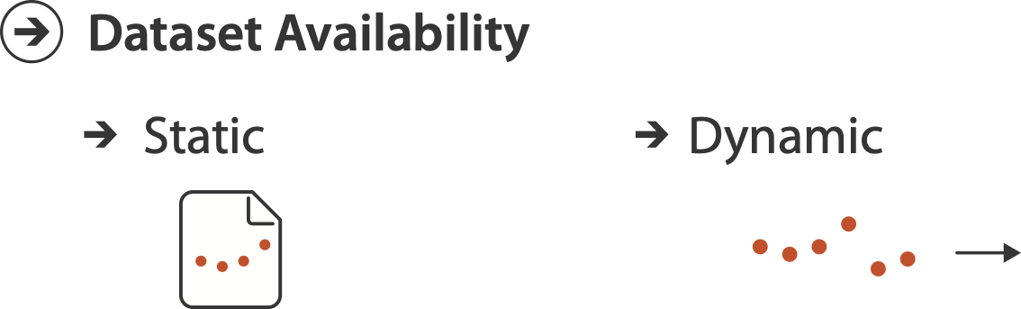
Other data concerns

Slide 44
Data abstraction: Three operations
translate from domain-specific language to generic visualization language
identify dataset type(s), attribute types
identify cardinality
how many items in the dataset?
what is cardinality of each attribute?
number of levels for categorical data
range for quantitative data
consider whether to transform data
guided by understanding of task

Slide 45
Data vs conceptual models
data model
mathematical abstraction
sets with operations, eg floats with * / - +
variable data types in programming languages
conceptual model
mental construction (semantics)
supports reasoning
typically based on understanding of tasks [stay tuned!]
data abstraction process relies on conceptual model
for transforming data if needed

Slide 46
Data vs conceptual model, example

Slide 47
Data vs conceptual model, example
data model: floats
32.52, 54.06, -14.35, ...

Slide 48
Data vs conceptual model, example
data model: floats
32.52, 54.06, -14.35, ...
conceptual model
temperature

Slide 49
Data vs conceptual model, example
data model: floats
32.52, 54.06, -14.35, ...
conceptual model
temperature
multiple possible data abstractions

Slide 50
Data vs conceptual model, example
data model: floats
32.52, 54.06, -14.35, ...
conceptual model
temperature
multiple possible data abstractions
continuous to 2 significant figures: quantitative
task: forecasting the weather

Slide 51
Data vs conceptual model, example
data model: floats
32.52, 54.06, -14.35, ...
conceptual model
temperature
multiple possible data abstractions
continuous to 2 significant figures: quantitative
task: forecasting the weather
hot, warm, cold: ordinal
task: deciding if bath water is ready

Slide 52
Data vs conceptual model, example
data model: floats
32.52, 54.06, -14.35, ...
conceptual model
temperature
multiple possible data abstractions
continuous to 2 significant figures: quantitative
task: forecasting the weather
hot, warm, cold: ordinal
task: deciding if bath water is ready
above freezing, below freezing: categorical
task: decide if I should leave the house today

Slide 53
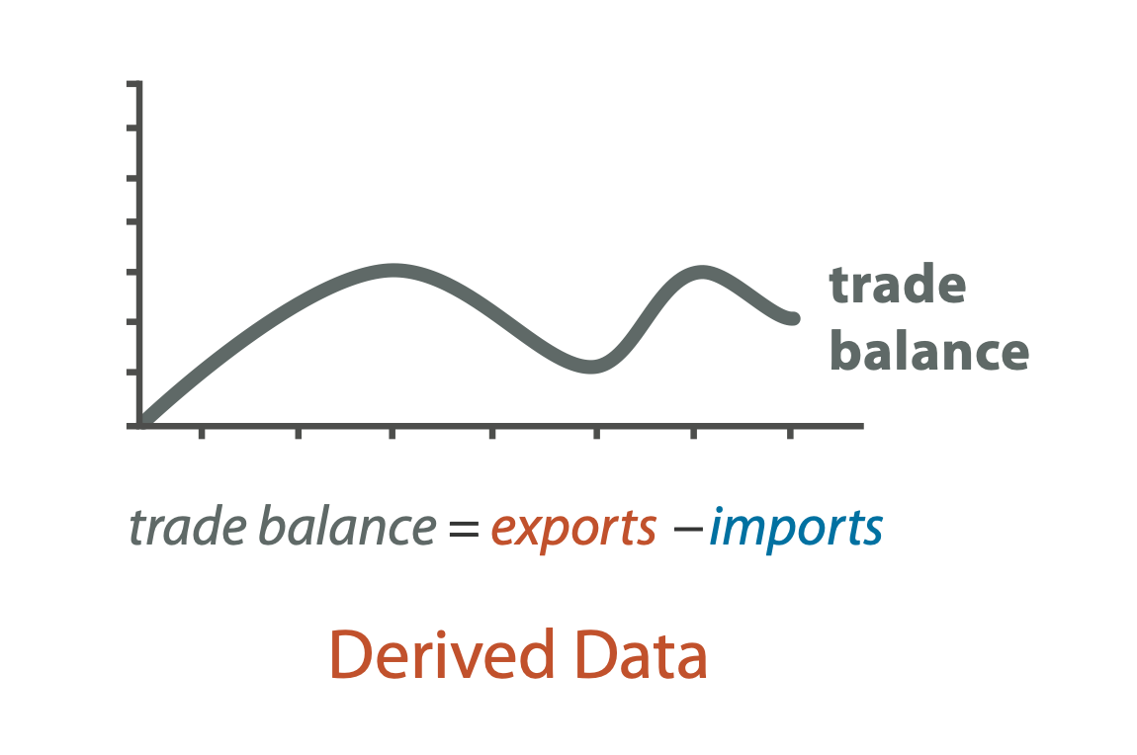
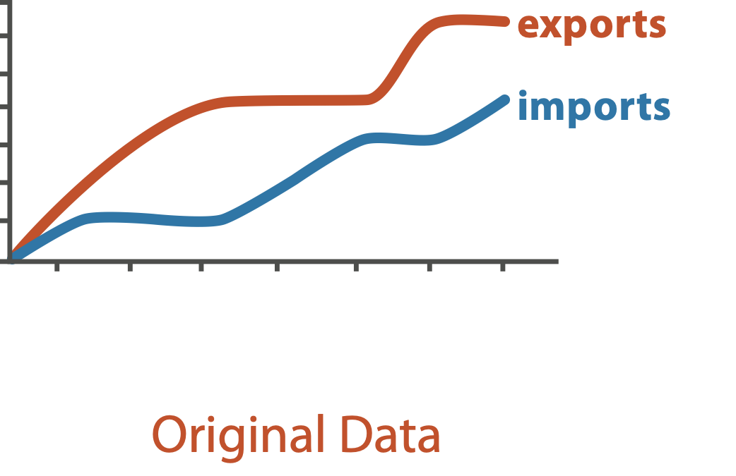
Derived attributes
derived attribute: compute from originals
simple change of type
acquire additional data
complex transformation

Slide 54
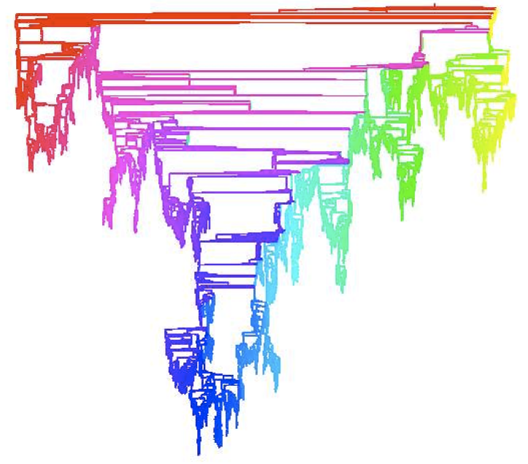
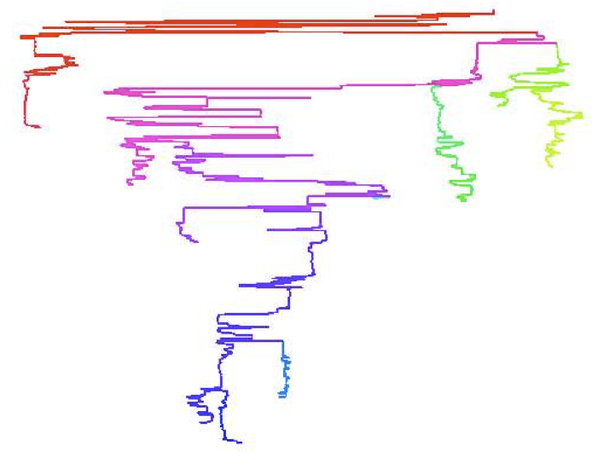
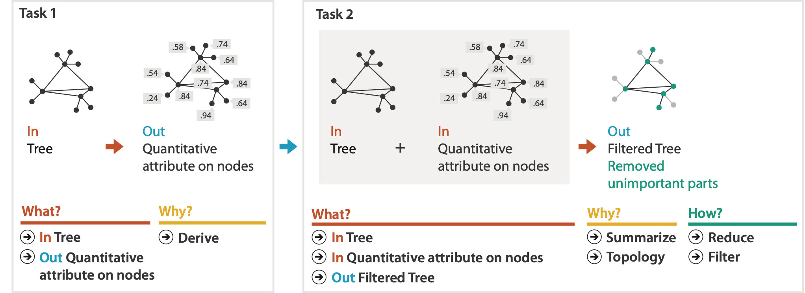
Analysis example: Derive one attribute
Strahler number
centrality metric for trees/networks
derived quantitative attribute
draw top 5K of 500K for good skeleton
[Using Strahler numbers for real time visual exploration of huge graphs. Auber. Proc. Intl. Conf. Computer Vision and Graphics, pp. 56–69, 2002.]

Slide 55
